Slide 1

April 11th 2019
Quasi-NEWTON mETHODS
EE381V: Large-Scale Optimization
Saadallah Kassir – Hassan Hmedi – Nithin RamESan – AKASH DOSHI

Slide 2
1- Background

Slide 3
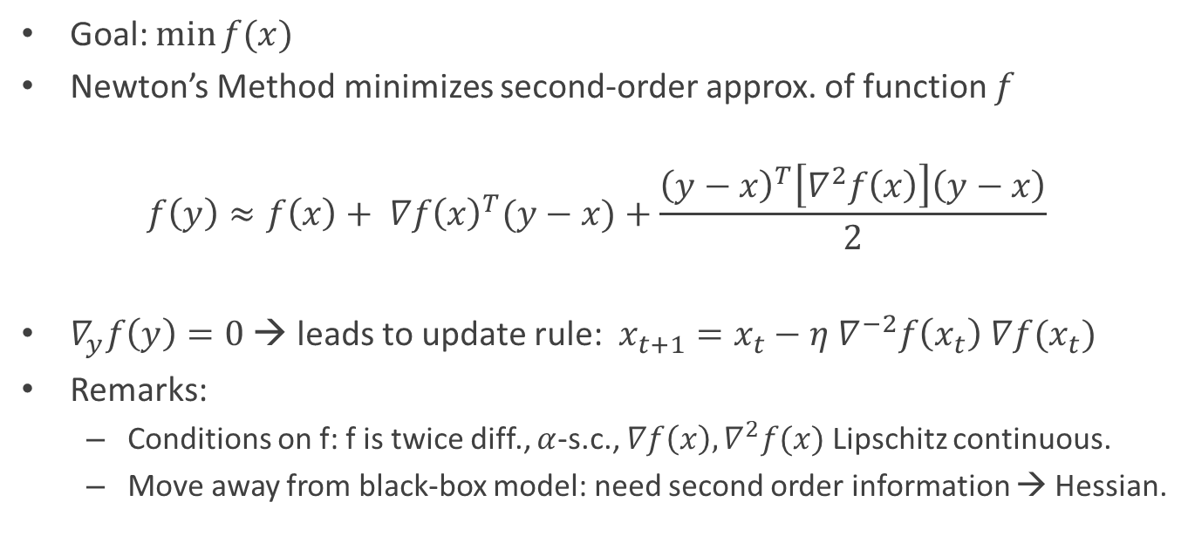
Newton’s Method
Goal: $\min{f(x)}$
Newton’s Method minimizes second-order approx. of function $f$
$$f\left(y\right)≈f\left(x\right)+ ∇f{\left(x\right)}^{T}(y−x)+\frac{{\left(y−x\right)}^{T}\left[∇^{2}f\left(x\right)\right]\left(y−x\right)}{2}$$
$∇_{y}f\left(y\right)=0$ → leads to update rule: $x_{t+1}=x_{t}−{η ∇}^{−2}f\left(x_{t}\right)$ $∇f(x_{t})$
Remarks:
Conditions on f: f is twice diff., $α$-s.c., $∇f\left(x\right),∇^{2}f(x)$ Lipschitz continuous.
Move away from black-box model: need second order information → Hessian.

Slide 4
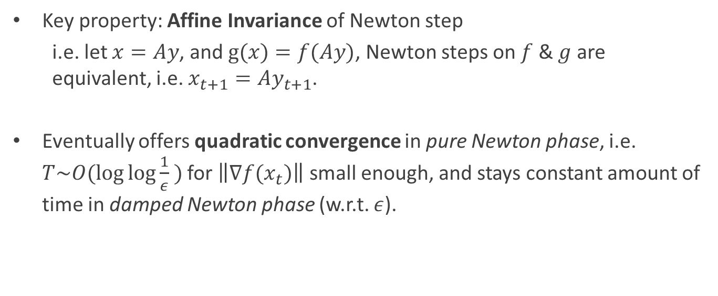
Why Newton?
Key property: Affine Invariance of Newton step
i.e. let $x=Ay$, and $g(x)=f(Ay)$, Newton steps on $f$ & $g$ are equivalent, i.e. $x_{t+1}=Ay_{t+1}$.
Eventually offers quadratic convergence in pure Newton phase, i.e. $T\sim O(\log{\log{\frac{1}{ε}} })$ for $\left\|∇f(x_{t})\right\|$ small enough, and stays constant amount of time in damped Newton phase (w.r.t. $ε$).

Slide 5
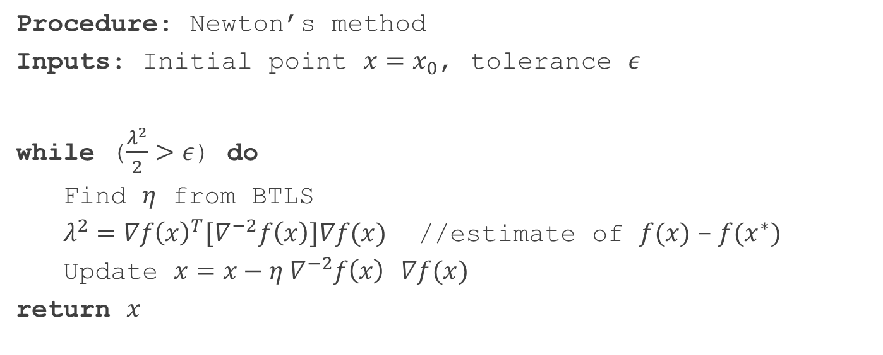
Newton’s Method Algorithm
Procedure: Newton’s method
Inputs: Initial point ${x=x}_{0}$, tolerance $ε$
while ($\frac{λ^{2}}{2}>ε$) do
Find $η$ from BTLS
$λ^{2}=∇f{\left(x\right)}^{T}{[∇}^{−2}f\left(x\right)]∇f(x)$ //estimate of $f(x)$- $f(x^{∗})$
Update $x=x−{η ∇}^{−2}f\left(x\right) ∇f(x)$
return $x$

Slide 6
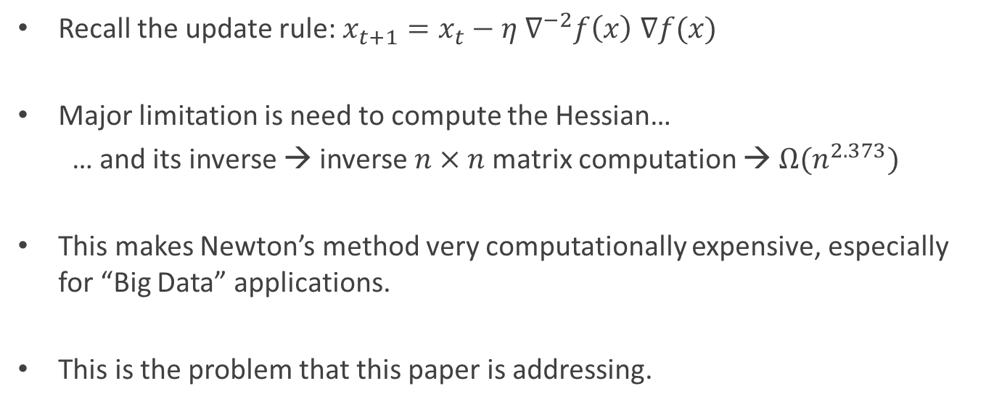
Limitation of Newton’s method
Recall the update rule: $x_{t+1}=x_{t}−{η ∇}^{−2}f\left(x\right)$ $∇f(x)$
Major limitation is need to compute the Hessian…
… and its inverse → inverse $n×n$matrix computation → $Ω(n^{2.373})$
This makes Newton’s method very computationally expensive, especially for “Big Data” applications.
This is the problem that this paper is addressing.

Slide 7
2- LiSSA Algorithm
Paper: Second-Order Stochastic Optimization for Machine-Learning in Linear Time
Authors: N. Agarwal, B. Bullins, E. Hazan

Slide 8
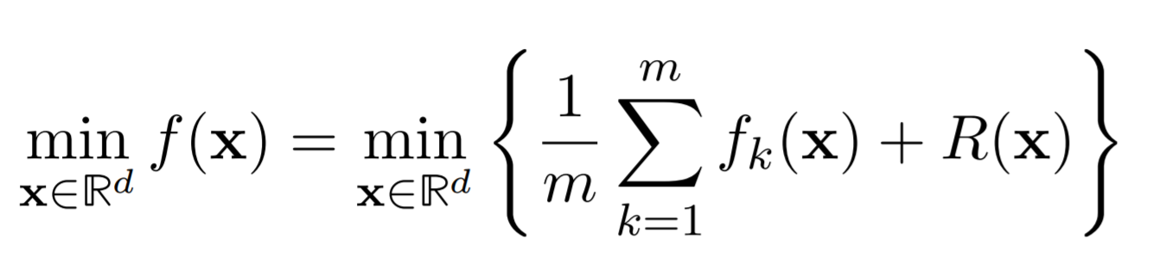
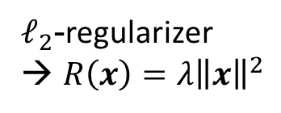
Overview
Goal:
Standard objective function in ML/ERM
We want to use second order methods to solve this problem
LiSSA: Linear (time) Stochastic Second order Algorithm
Especially efficient for GLMs
Convex
$ℓ_{2}$-regularizer → $R\left(x\right)=λ{\left\|x\right\|}^{2}$

Slide 9
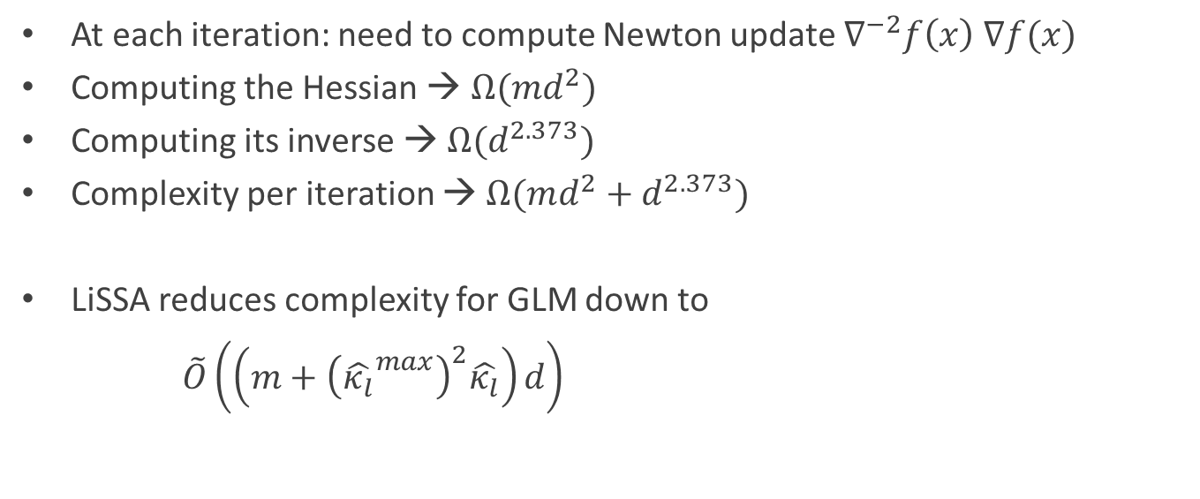
Problem
At each iteration: need to compute Newton update $∇^{−2}f\left(x\right)$ $∇f(x)$
Computing the Hessian → $Ω(md^{2})$
Computing its inverse → $Ω(d^{2.373})$
Complexity per iteration → $Ω({md^{2}+d}^{2.373})$
LiSSA reduces complexity for GLM down to
$\tilde{O}\left(\left(m+{\left({\hat{κ_{l}}}^{max}\right)}^{2}\hat{κ_{l}}\right)d\right)$
d
1
D
x
m
d

Slide 10
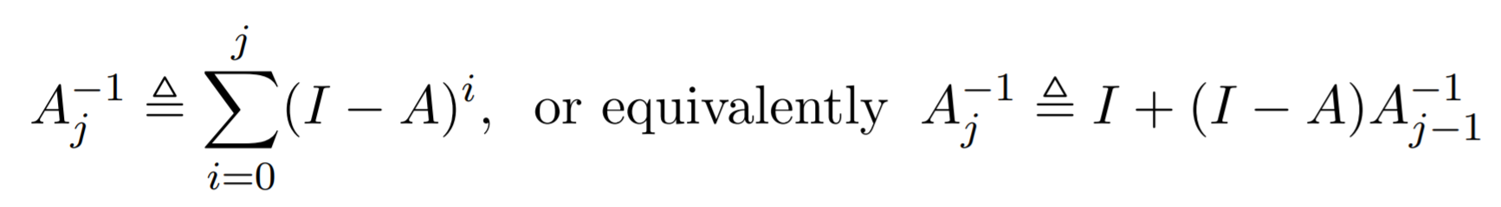
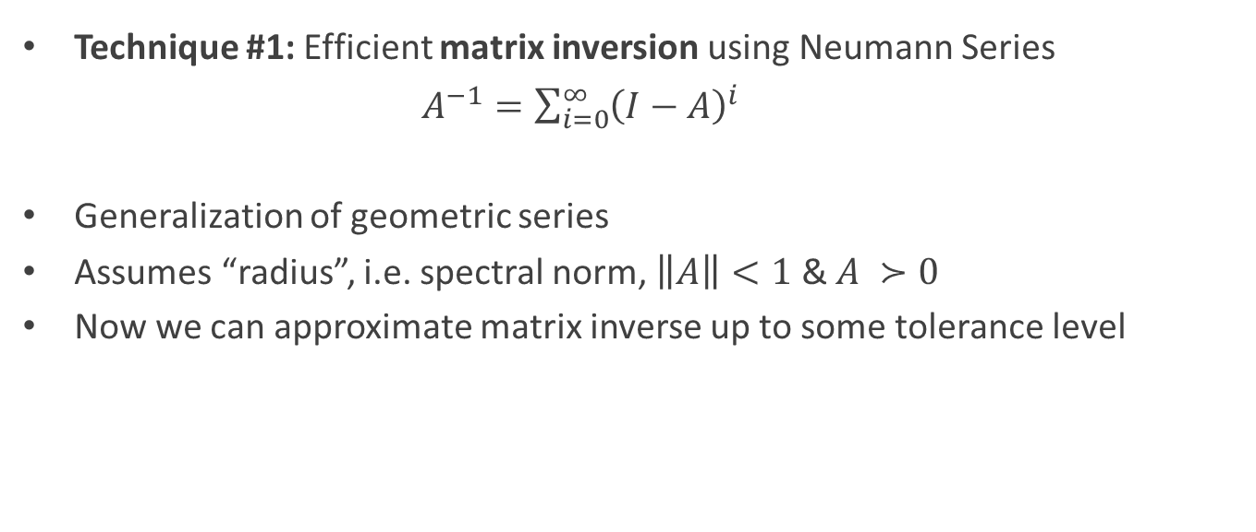
Overview of Techniques
Technique #1: Efficient matrix inversion using Neumann Series
$A^{−1}=\sum_{i=0}^{∞}{{\left(I−A\right)}^{i}}$
Generalization of geometric series
Assumes “radius”, i.e. spectral norm, $\left\|A\right\|<1$ & $A ≻0$
Now we can approximate matrix inverse up to some tolerance level
Controls approximation error → parameter in LiSSA

Slide 11
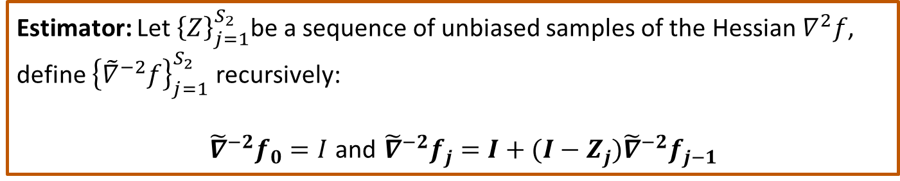
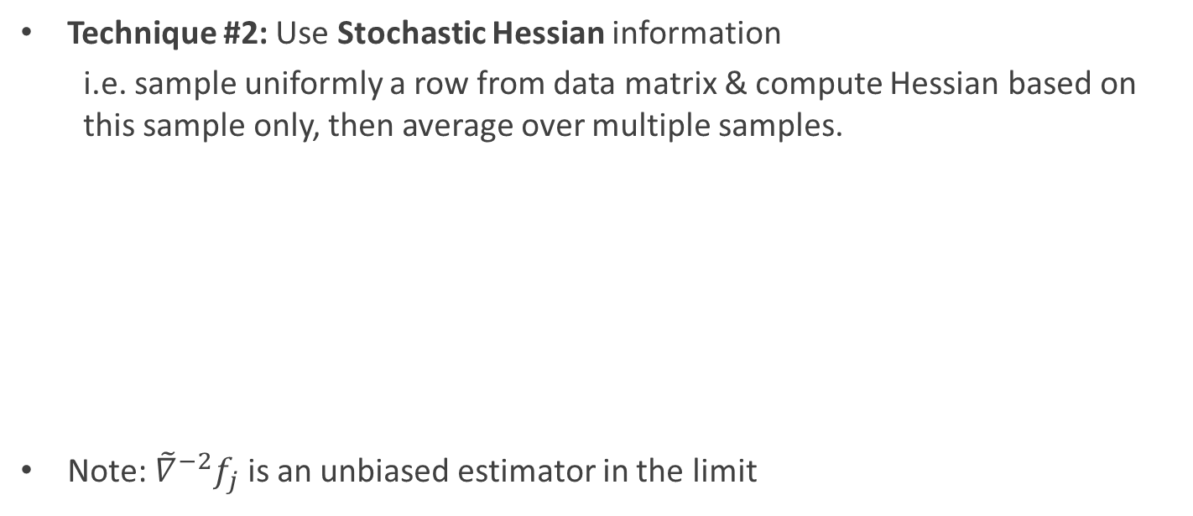
Overview of Techniques
Technique #2: Use Stochastic Hessian information
i.e. sample uniformly a row from data matrix & compute Hessian based on this sample only, then average over multiple samples.
Note: ${\tilde{∇}}^{−2}f_{j}$ is an unbiased estimator in the limit
Estimator: Let ${\left\{Z\right\}}_{j=1}^{S_{2}}$be a sequence of unbiased samples of the Hessian $∇^{2}f$, define ${\left\{{\tilde{∇}}^{−2}f\right\}}_{j=1}^{S_{2}}$ recursively:
${\tilde{∇}}^{−2}f_{0}=I$ and ${\tilde{∇}}^{−2}f_{j}=I+(I−Z_{j}){\tilde{∇}}^{−2}f_{j−1}$

Slide 12
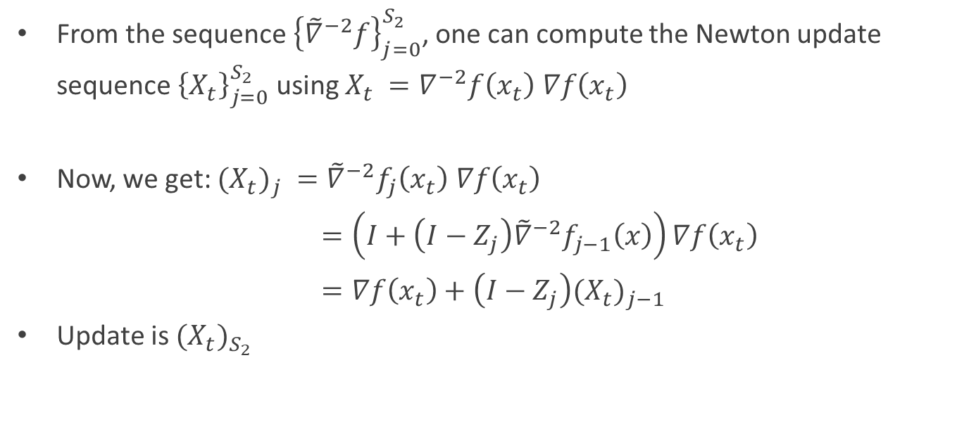
Estimation of Newton Step
From the sequence ${\left\{{\tilde{∇}}^{−2}f\right\}}_{j=0}^{S_{2}}$, one can compute the Newton update sequence ${\left\{X_{t}\right\}}_{j=0}^{S_{2}}$ using $X_{t} =∇^{−2}f\left(x_{t}\right) ∇f\left(x_{t}\right)$
Now, we get: ${{(X}_{t})}_{j} ={\tilde{∇}}^{−2}f_{j}\left(x_{t}\right) ∇f\left(x_{t}\right)$
$=\left(I+\left(I−Z_{j}\right){\tilde{∇}}^{−2}f_{j−1}\left(x\right)\right)∇f\left(x_{t}\right)$
$=∇f\left(x_{t}\right)+\left(I−Z_{j}\right){{(X}_{t})}_{j−1}$
Update is ${{(X}_{t})}_{S_{2}}$

Slide 13
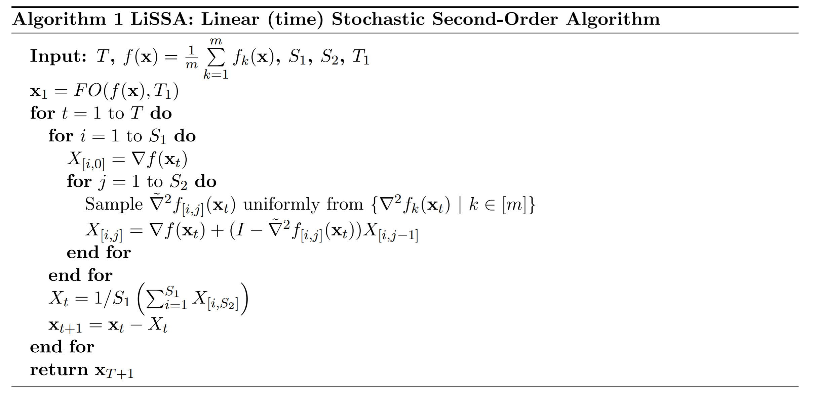
The LiSSA Algorithm
// Warm start, First Order algo, e.g. Accelerated SVRG
// Sample stochastic Hessian
// Compute Newton Update

Slide 14
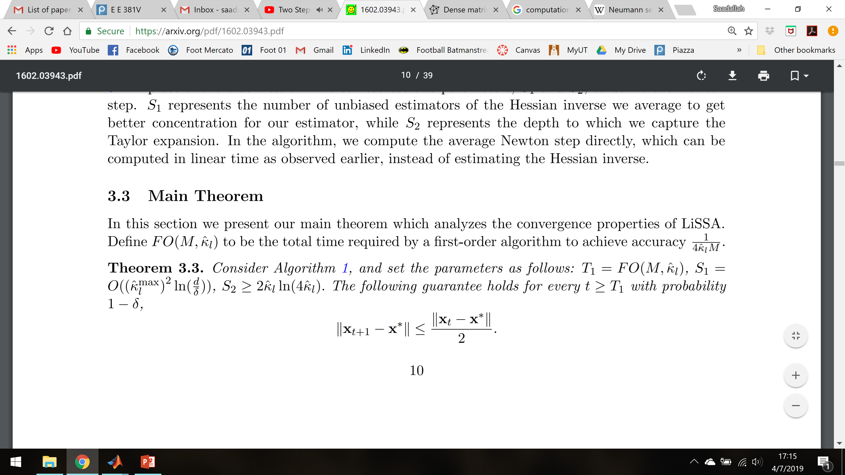
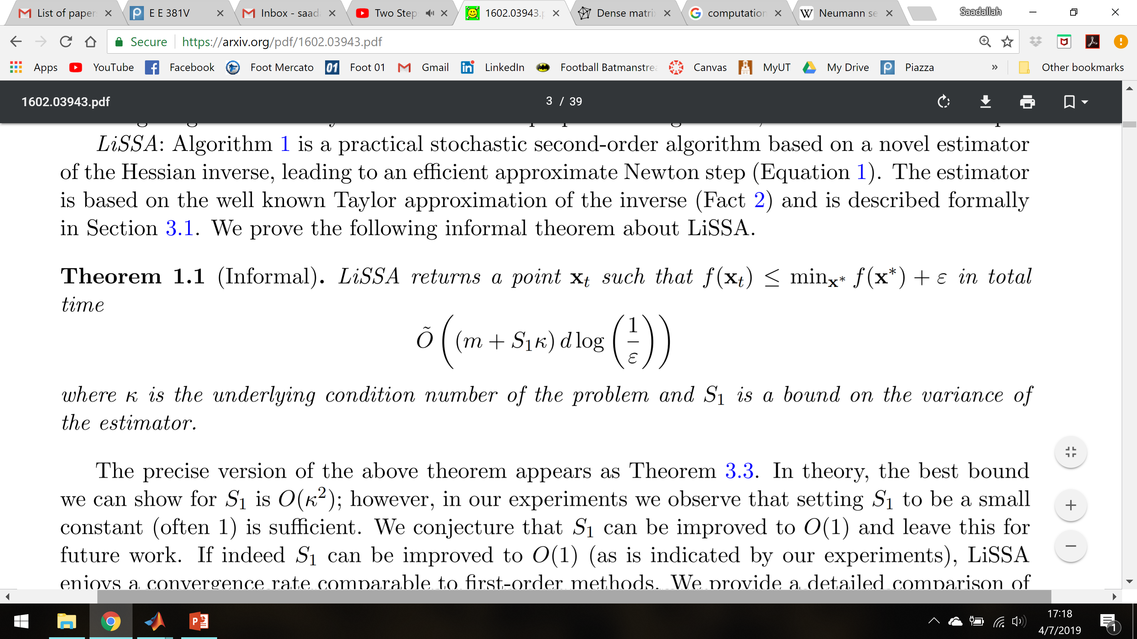
Main Theorem
LiSSA converges linearly
Giving for GLMs a complexity of:
Notes:
Talk about extensions: sparsity and non-GLMs, & some parameters can be relaxed
Improvement compared to GD: O(kappa*m*d)

Slide 15
Simulation Results
Code Repository: https://github.com/Saadallah-Kassir/ConvexOptLiSSA

Slide 16
More Experiments
m | n | LiSSA | Newton | Speedup
1,000 | 50 | 4.9816 e-3 | 0.2303 e-4 | 0.00046
10,000 | 50 | 1.0493 e-2 | 9.9649 e-4 | 0.095
100,000 | 50 | 9.3113 e-2 | 1.4348 e-2 | 0.15
10,000 | 500 | 9.8538 e-2 | 8.1522 e-2 | 0.83
50,000 | 1,000 | 0.9190 | 1.0721 | 1.17
100,000 | 5,000 | 8.5320 | 35.0690 | 4.11
Time taken (in seconds) per epoch for different data matrix sizes
Machine: Intel Core i7-8550U CPU @1.80GHz, 16GB RAM

Slide 17
3- LiSSA-Quad

Slide 18
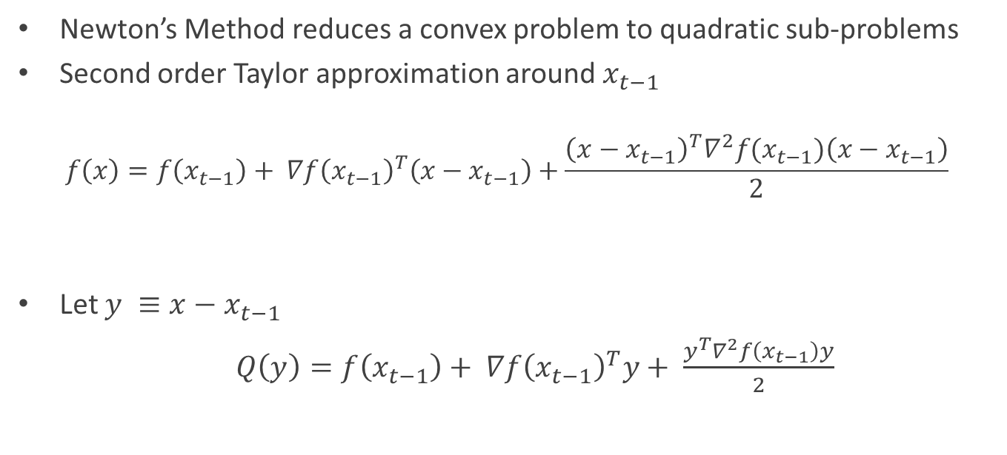
Overview
Newton’s Method reduces a convex problem to quadratic sub-problems
Second order Taylor approximation around $x_{t−1}$
$$f\left(x\right)=f\left(x_{t−1}\right)+ ∇f{\left(x_{t−1}\right)}^{T}\left(x−x_{t−1}\right)+\frac{{\left(x−x_{t−1}\right)}^{T}∇^{2}f(x_{t−1})\left(x−x_{t−1}\right)}{2}$$
Let $y ≡x−x_{t−1}$
$Q\left(y\right)=f\left(x_{t−1}\right)+ ∇f{\left(x_{t−1}\right)}^{T}y+ \frac{y^{T}∇^{2}f\left(x_{t−1}\right)y}{2}$

Slide 19
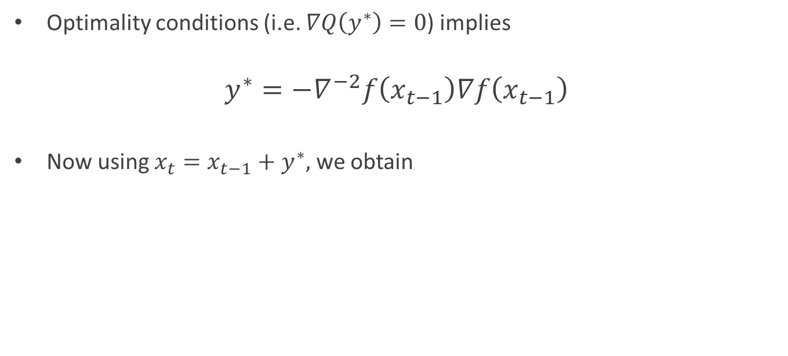
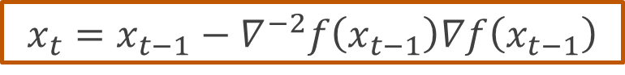
Overview (Cont’d)
Optimality conditions (i.e. $∇Q\left(y^{∗}\right)=0$) implies
$$y^{∗}=−∇^{−2}f\left(x_{t−1}\right)∇f\left(x_{t−1}\right)$$
Now using $x_{t}=x_{t−1}+y^{∗},$ we obtain
$$x_{t}=x_{t−1}−∇^{−2}f\left(x_{t−1}\right)∇f\left(x_{t−1}\right)$$
Newtonian step

Slide 20
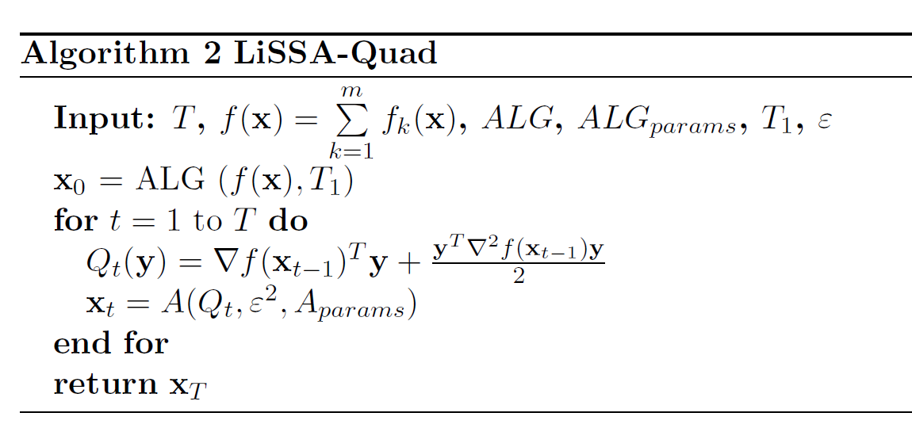
LiSSA-Quad Algorithm
// Warm start
// Use any first-order linearly convergent algorithm

Slide 21
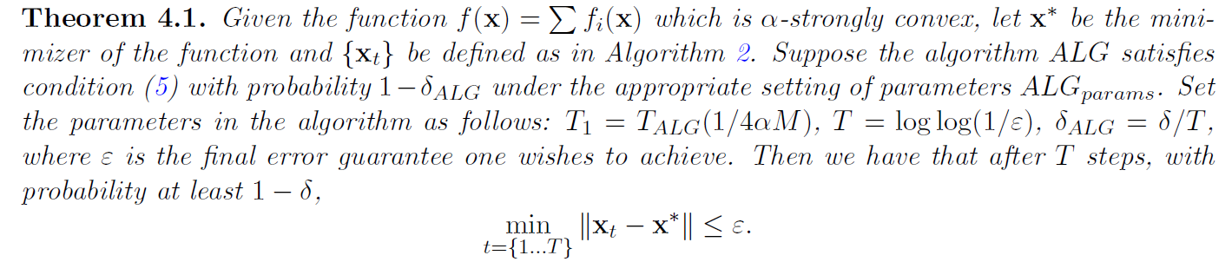
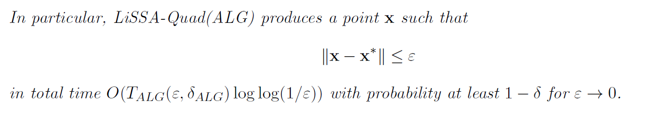
Main Theorems

Slide 22
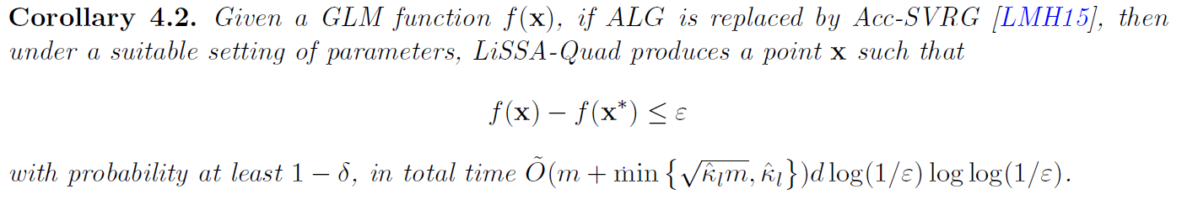
Main Theorems (Cont’d)
Note that each of the $f_{i}$functions is smooth

Slide 23
Simulation Results
Code Repository: https://github.com/Saadallah-Kassir/ConvexOptLiSSA

Slide 24
3- LiSSA-Sample

Slide 25
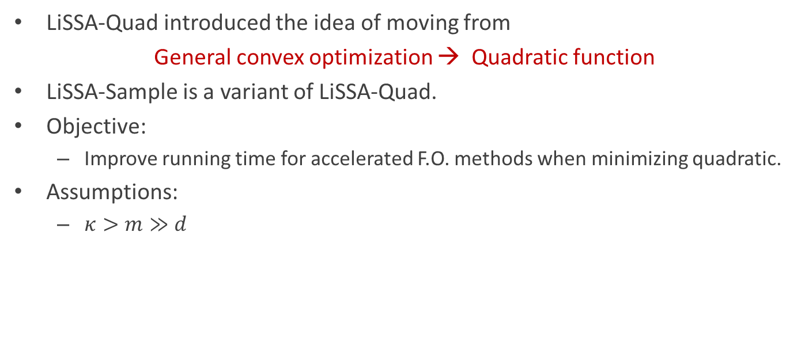
Runtime Improvement
LiSSA-Quad introduced the idea of moving from
General convex optimization → Quadratic function
LiSSA-Sample is a variant of LiSSA-Quad.
Objective:
Improve running time for accelerated F.O. methods when minimizing quadratic.
Assumptions:
$κ>m≫d$

Slide 26
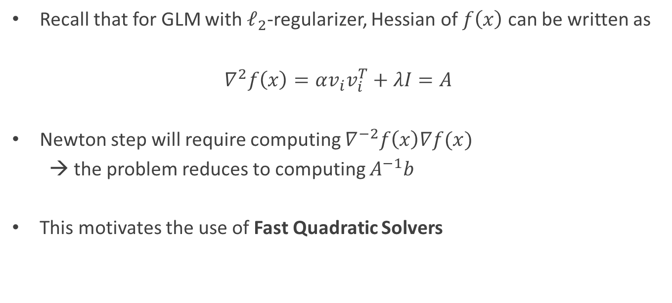
Property of GLM
Recall that for GLM with $ℓ_{2}$-regularizer, Hessian of $f\left(x\right)$ can be written as
$∇^{2}f\left(x\right)=αv_{i}v_{i}^{T}+λI=A$
Newton step will require computing $∇^{−2}f\left(x\right)∇f(x)$
→ the problem reduces to computing $A^{−1}b$
This motivates the use of Fast Quadratic Solvers

Slide 27
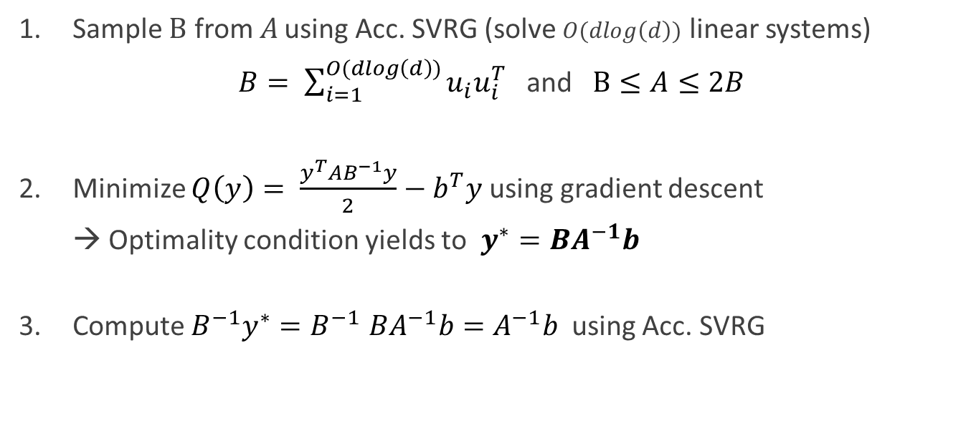
Fast Quadratic Solvers
Sample $B$ from $A$ using Acc. SVRG (solve $O(dlog\left(d\right))$ linear systems)
$B= \sum_{i=1}^{O(dlog\left(d\right))}{u_{i}u_{i}^{T}}$ and $B≤A≤2B$
Minimize $Q\left(y\right)= \frac{y^{T}AB^{−1}y}{2}−b^{T}y$ using gradient descent
→ Optimality condition yields to $y^{∗}=BA^{−1}b$
Compute $B^{−1}y^{∗}{=B}^{−1}BA^{−1}b=A^{−1}b$ using Acc. SVRG

Slide 28
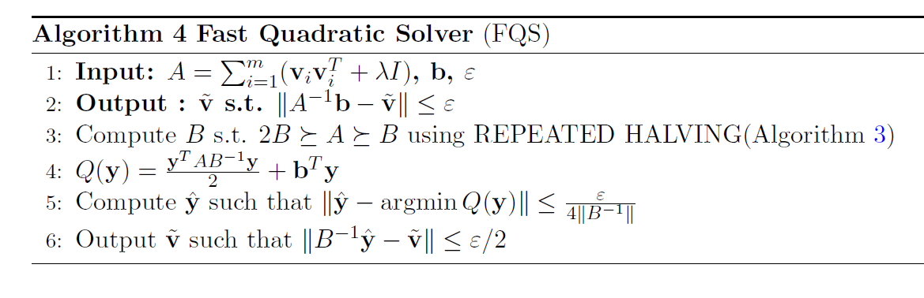
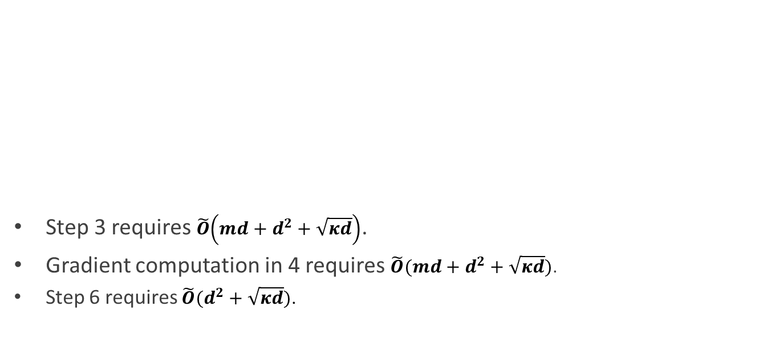
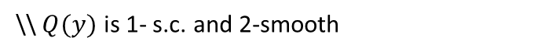
Algorithm
Step 3 requires $\tilde{O}\left(md+d^{2}+\sqrt{κd}\right)$.
Gradient computation in 4 requires $\tilde{O}(md+d^{2}+\sqrt{κd})$.
Step 6 requires $\tilde{O}(d^{2}+\sqrt{κd})$.
\\ $Q(y)$ is 1- s.c. and 2-smooth

Slide 29
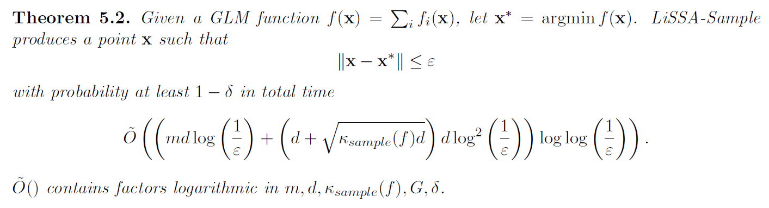
Main Theorem

Slide 30
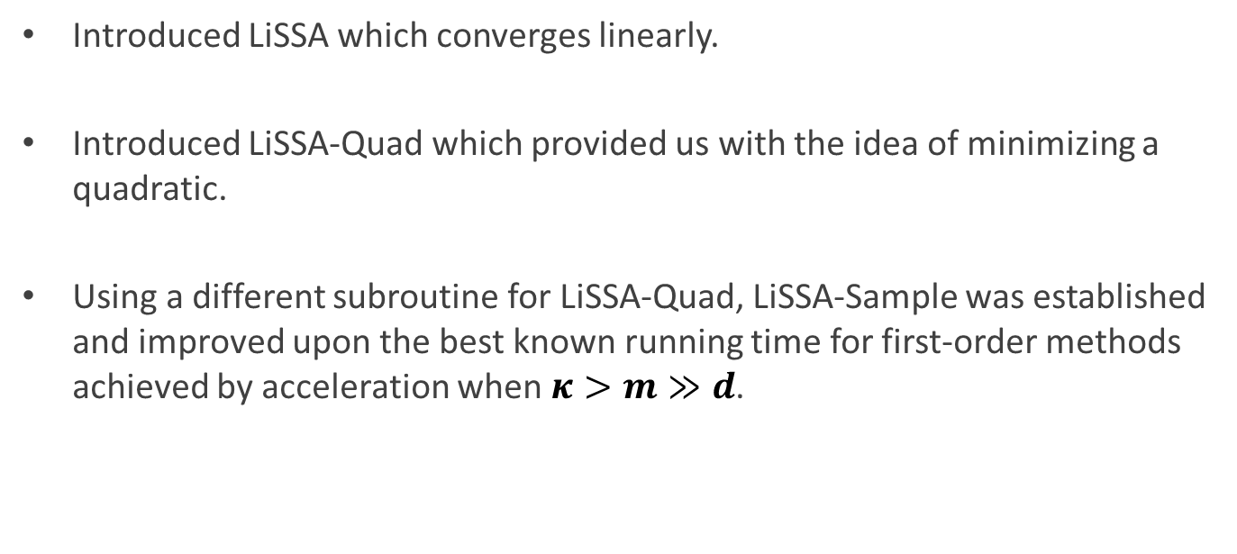
Conclusions
Introduced LiSSA which converges linearly.
Introduced LiSSA-Quad which provided us with the idea of minimizing a quadratic.
Using a different subroutine for LiSSA-Quad, LiSSA-Sample was established and improved upon the best known running time for first-order methods achieved by acceleration when $κ>m≫d$.

